Slide 1

ARTIFICIAL INTELLIGENCE
: Deepankar Sharma

Slide 2
CONTENTS
01
INTELLIGENCE
P01
02
INTUITION OF AI
P02
03
OPTIMISM
P03
04
HOW FAR WE ARE UPTO
P04

Slide 3
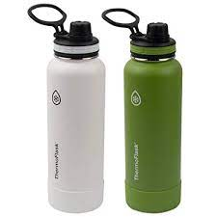
INTELLIGENCE
1. How to determine the most INTELLIGENT GUY in the class?
-> Topper
-> he scored more than anyone
2. How about a thermoflask
-> can be intelligent too ^_^
-> keeps water hot better than anyone

Slide 4
THEORY VS MODELLING VS APPLICATIONS
1
2
3
THEORY
MODELLING
APPLICATIONS
Having an idea about the solution in the mind
Converting a problem into computational problem
Deploying the model into the real world

Slide 5
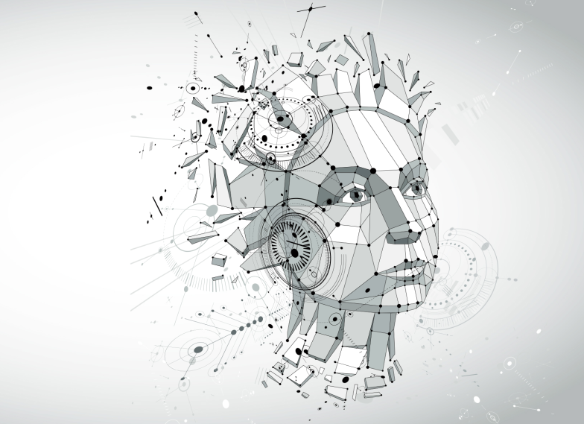
INTUITION OF ARTIFICIAL INTELLIGENCE

Slide 6
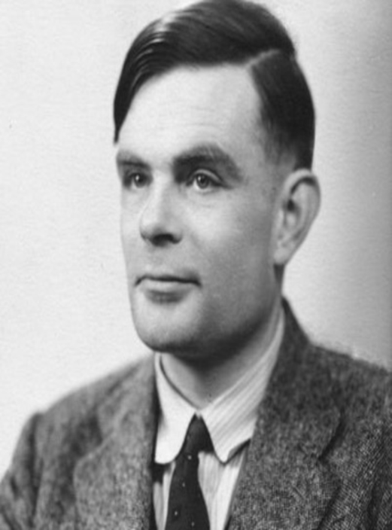
ALAN TURING & THE FAMOUS TURING TEST

ALAN TURING
FATHER OF COMPUTER SCIENCE
✶
‘ I consider to propose the question : CAN MACHINES THINK?
⇩
TURING TEST
To check wheather a machine can think ?

Slide 7
What is AI ?
Thinking and acting like HUMANS ?
-> are humans always intelligent?
Rationality in THINKING ?
-> Emotions cloud judgements!!!!!!!!!!!
CAN solve Pretty much every problem in the world?
-> trying to make our own god xD

Slide 8
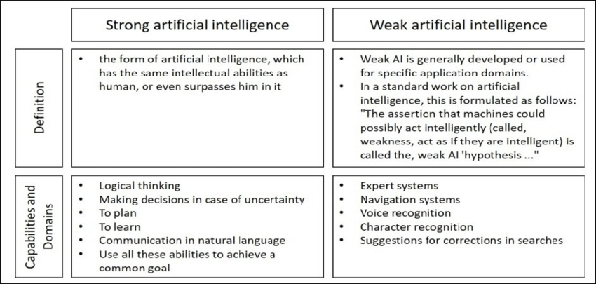
AI HYPOTHESIS

Slide 9
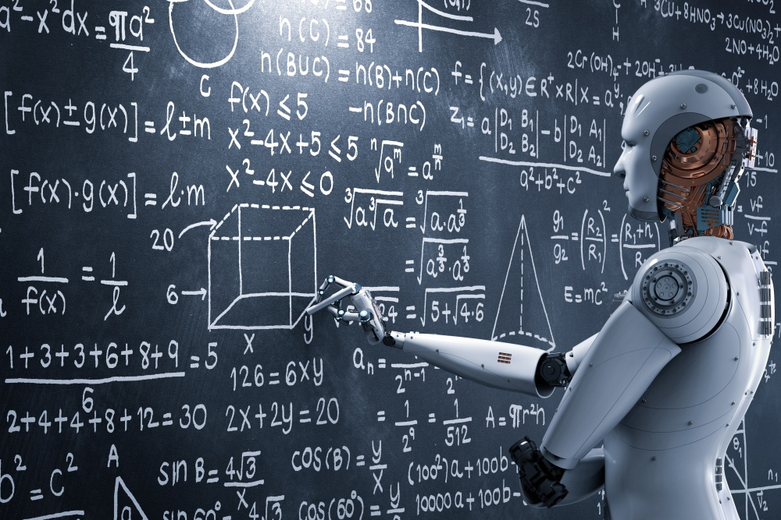
OPTIMISM

Slide 10
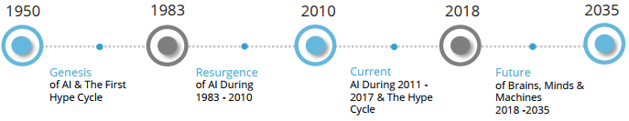
AI REASEACHERS ARE HIGHLY OPTIMISTIC
1956
probablity
DEEP NEURAL NETWORKS
AI WAS BORN
Founding fathers
- John Mc CArthy
- Alan Newell
- Herbert Simon
- Marwin Minsky

Slide 11
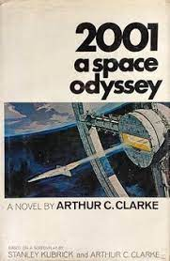
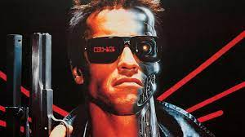
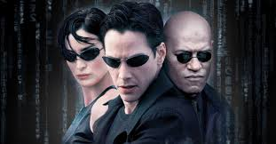

Optimism in MOVIES
AI Being The Core Concept of Every sci-fi
so many ai based Blockbusters
1968
1984
1994
2014

Slide 12
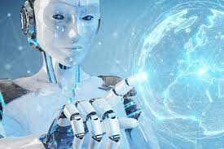
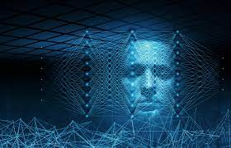
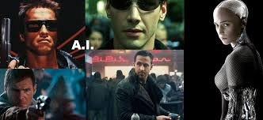
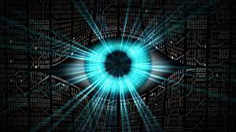
THE ROAD SO FAR

Slide 13
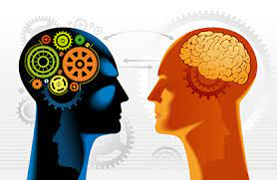
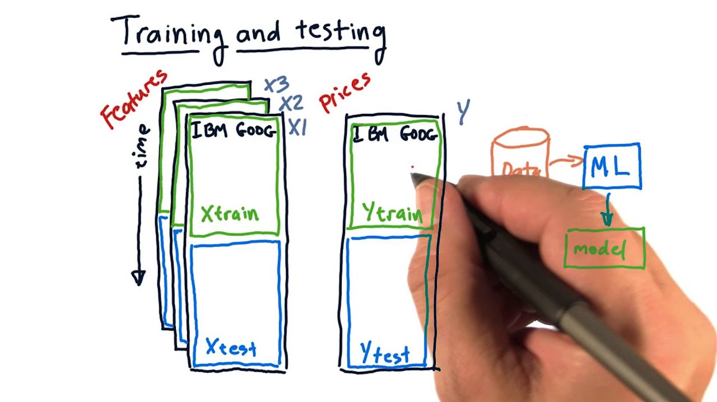
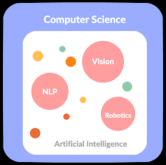
NLP _SML

Slide 14

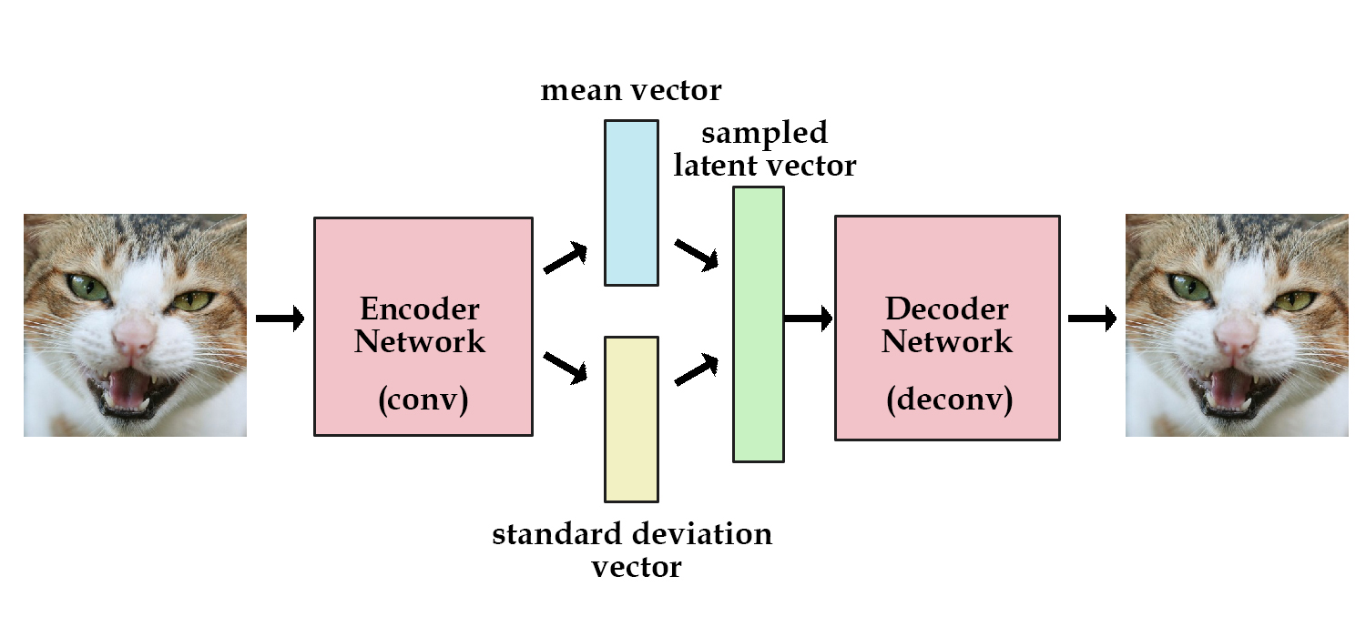

CNN _VAE

Slide 15
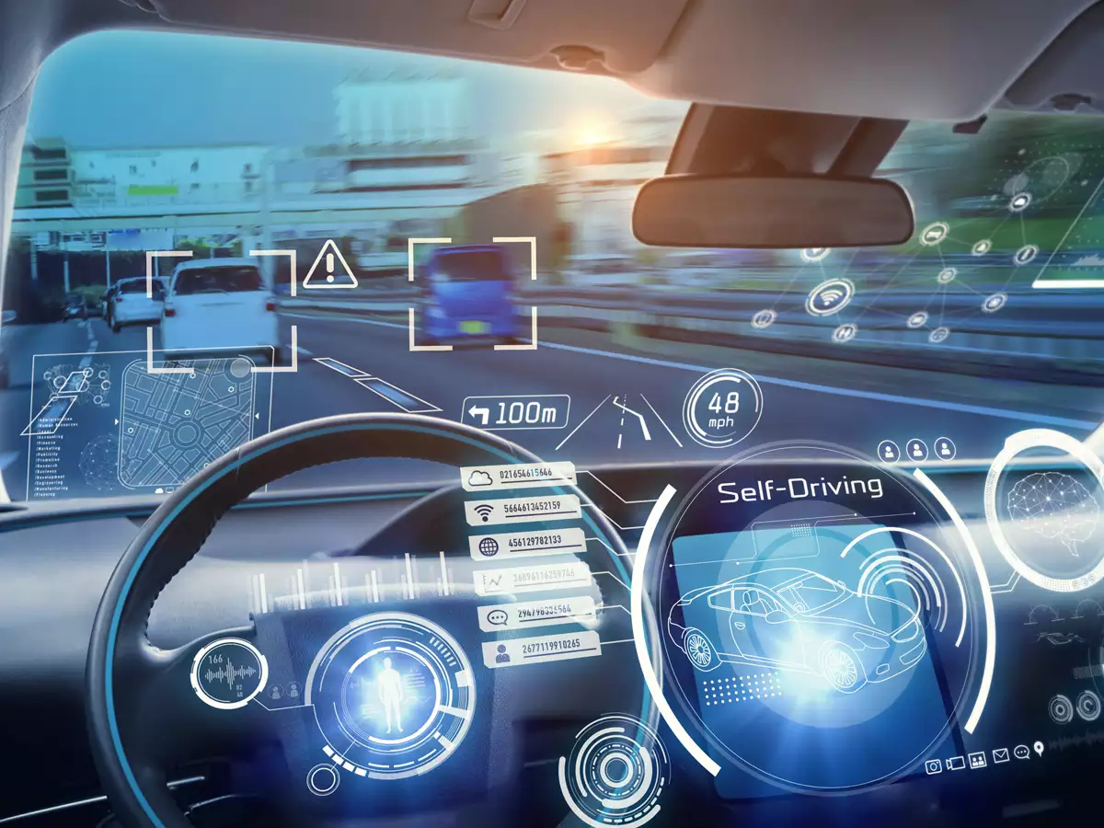
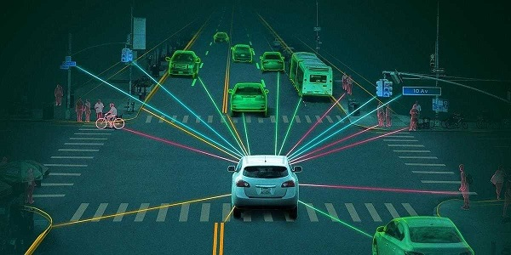
Auto Driven cars

Slide 16

COMPETITING HUMANS IN PRETTY MUCH EVERYTHING

Slide 17
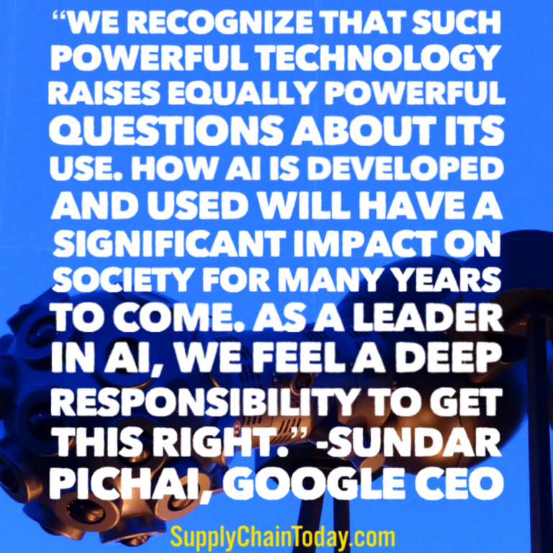

Slide 18
THANK YOU

